Slide 1
Accelerating the QA Test Cycle Via Metrics and Automation (Larry Mellon, Brian DuBose)
Introduction to T&M in MMO
Implementation options for T&M
LL from QA side
  What worked
  What were bottlenecks
  What needs to change for success
LL from Prod side
  What worked
  What were bottlenecks
  What needs to change for success
  Key takeaway: QA/Prod NOT separate groups in MMO world!
    T&M tools help bind the fragmented team into a rapid cycle for the full design/build/test/deploy/collect&analyze process
    T&M help everybody do their jobs faster & with less pain & less long-term cost

Slide 2
NEW Outline [author notes]
Intro [keep as overview]
  QA responsibility in MMOs greater than older games (‘pixels on screen ‘ theory must die, ‘brick wall’ must come down)
  Why automated T&M needed in MMO
  Bio: larry & brian
BD: QA LL in designing & fielding T&M from QA side
LM: Prod LL in designing & fielding T&M from Prod and overall team wins (QA, marketing, server eng, game designers, …)
New theme!
  Cut back on T&M impl (give them ref ptrs), but add new Peter charts into process part
  Focus on: (quick impl options) (deeper look at what failed/worked)
    applications of T&M in MMO Prod/QA/Live, including commutation value of automated user stories!
    Blocking issues hit & how solved
    What cultural, technology and process issues need to shift for MMO T&M success
  Example: BD had studio head support, tech lead support and manpower, but was blocked by lack of architectural support, feature-level visibility / priority, and senior engineering support in analysis and design of a large, complex feature (T&M)
  LM focus: good and bad architectural choices, impact on Prod, QA; and a new Prod&QA team&tools&lingo approach that worked

Slide 3
Traditional Game QA fails for MMOs
(need tightly bound teams to meet rapid iteration requirements)
Builds & feature specs
Production
QA
Brick wall
Bugs & game health reports
Notes:
Scale up with temp testers as Ship date approaches,
Scale down post-Gold

Slide 4
MMOs add new QA requirements
Boxed goods mentality
Online service reality
Wrong assumptions lead to painful decisions!
Long-term Customer Satisfaction:
Everything works, all the time,
Even as game & players evolve!
Notes:
Larry:
So it seems to break down to a cultural problem: executives from the box goods industry are used to spending money lavishly on “features”, and only grudgingly on infrastructure (Sims 2: always complaining about their tools for a 120 person team, but ZERO tools engineers!)
What a lot of studios are missing is that an online game is a game and a service!
In an service industry, customer retention is king, and metrics are just as critical as the ‘jump’ button!
Yet we continually make critical decisions off of guesses, not data, and hope to get lucky, 1,000’s of times in a row!

Slide 5
QA requirements vary over phases of production and operations
First, stabilize & accelerate the game iteration process
  The game is a tool used in building the game
  Prod & QA and need fresh & frequent builds, with fast load times!
  Debugs test/deploy steps early: create 0% failure cycle before scale hits
Loose validation checks to start, while game design & code are still shifting, tighter Validation post-Alpha
Setup for load testing early, start running small loads ASAP
  Scale test clients & pipeline w/mock data
Set up for Live Ops early!!!
  Test response times @ mock scale, project recurring costs & new guys (CM lead, …)
  Cheap, fast & fault-free cycle: triage/fix/verify/deploy

Slide 6
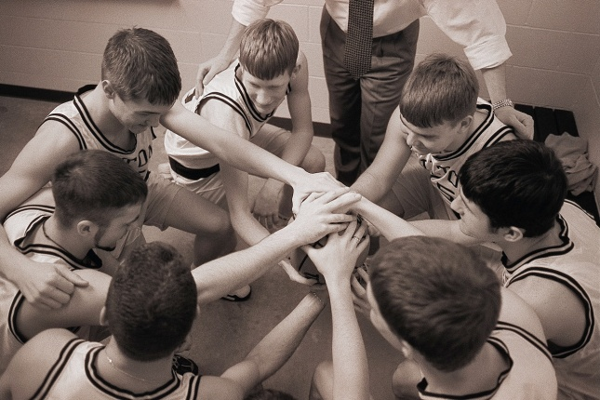

Tech problem: small & simple have become big & clumsy
Team
Size
~5 to ~50 (tightly knit) people
~50 to ~300 (loosely coupled) people
~500K SLOC & ~1Gig Content
(1 CPU & 1 GPU)
~5M SLOC & ~10Gig Content
(multi-core CPU & GPU)
Implementation
Complexity

Slide 7
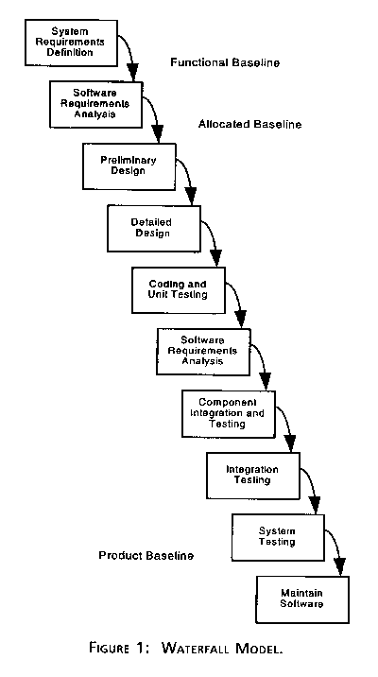

Catch-22: some standard techniques to deal with large scale teams & implementation complexity collide with iteration!
ISO 9000
Core assumption:
You can know what you’re building & write it down, before you build it
Mil-Spec 2167A

Slide 8
Tech problem: multi-player
(Use case: steal ball being dribbled by another player)
(needs 2 to 10 manual testers to cover all code paths!)
Network Distortion = Non-deterministic bugs
Player A (San Francisco)
?
Player B (New York)
?
Ball Position:
State Updates
?
Local machine always has an accurate
representation of ball position
Remote machine always has
an approximation of ball position

Slide 9
Game designs are also scaling out of (easy) control, killing current test & measure approaches
And MMO designs evolve…
And player style evolves…
Thus, testing must evolve as game design & testing assumptions shift

Slide 10
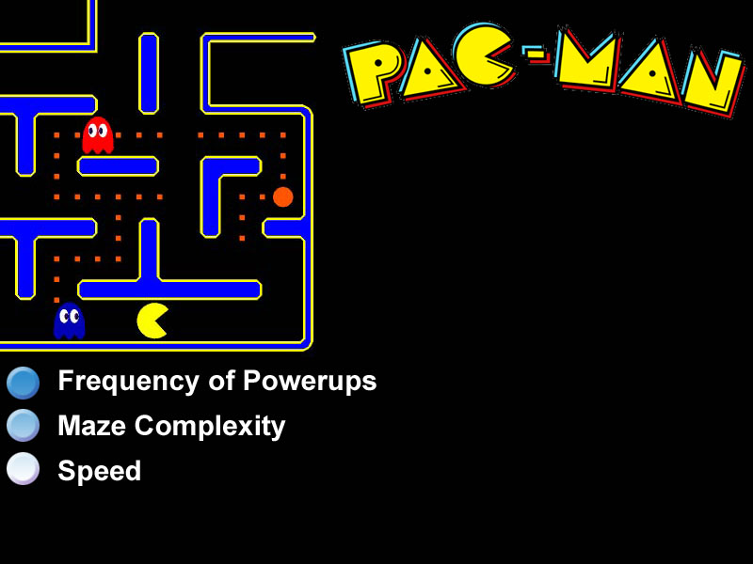
Next Gen Games
Increased Complexity
Increased Complexity of Analysis
Art from “Fun Meters for Games”,
Nicole Lazzaro and Larry Mellon

Slide 11
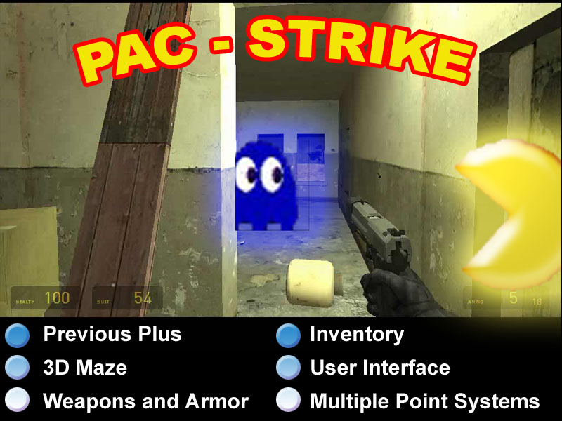

Slide 12
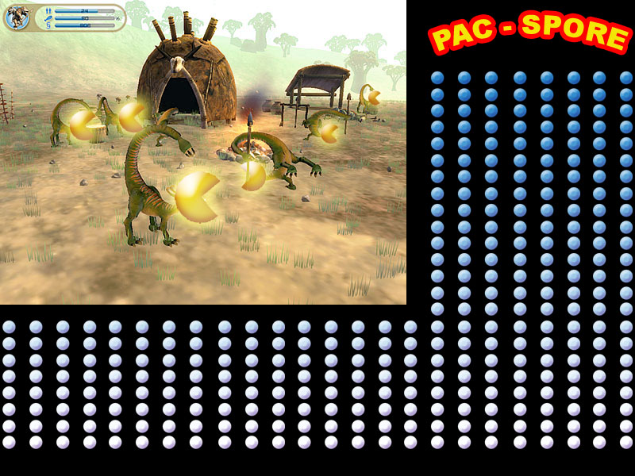
Next Gen Games

Slide 13
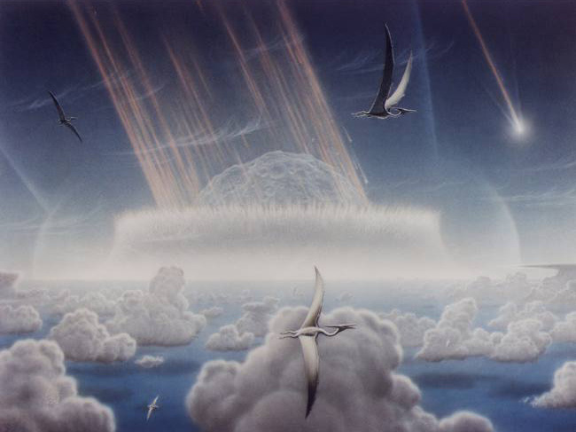
Growing design & code complexity, and built by larger teams, may be our own Dinosaur Killer
MMOs and multi-core consoles are hard enough today:
What does the future hold?

Slide 14
Massively multi-core: pain, pain, pain
Extracting concurrency – safely – is tough
  For every slice of real-time, you need to find something useful for each core to do!
    Requiring little data from other modules
    With few/no timing dependencies
    More cores == more hassle
  Now do the above
    While the player(s) dynamically change their behavior
      Dynamic CPU & memory load balancing
    Quickly enough to keep up with game design iteration
      While not breaking anything, ever
Code: "If we can figure out how to program thousands of cores on a chip, the future looks rosy. If we can't figure it out, then things look dark.“ David Patterson, UC (Berkeley)
Content: imagine filling the content maw of
PS4 & Xbox 720?

Slide 15
Scale mitigation: automation has the computers do the hard work for you…
Automate the triage/analyze/fix/validate cycle
  Automated testing: faster, cheaper, more accurate @ scale
  Helper ‘bots to speed QA and Prod bottleneck tasks
Automating Metrics
  Collection (client/server data, process data, player data)
  Aggregation (high level views of massive data sets, past or present)
  Distribution (team members, history, management, …)
    If a metric is collected in the woods and no one was there to see it, did it really matter? (LL: TS2 metrics collision)
  Trigger ‘bots can spot patterns and call for human analysis
    E.g.: gold rates are higher today than ever before, and only from one server & one IP address…

Slide 16
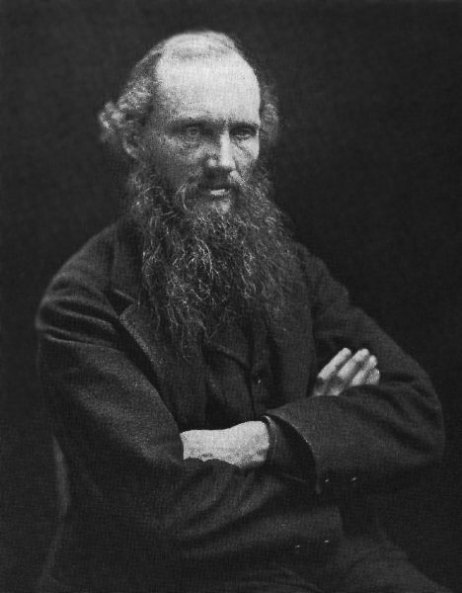

Metrics help manage complexity & scale
(code, design, team, tests)
“When you can measure what you are speaking about and can express it in numbers, you know something about it.
But when you cannot measure it, when you cannot express it in numbers, your knowledge is of a meager and unsatisfactory kind."
- Lord Kelvin Institution of Civil Engineers, 1883
“The general who wins the battle makes many calculations in his temple before the battle is fought. The general who loses makes but few calculations beforehand.”
-- Sun Tzu

Slide 17

“The three largest factors that will influence gaming will be […] and metrics (measuring what players do and responding to that)”
-- Will Wright
The Secret of The Sims", PC Magazine, 2002. http://www.pcmag.com/article2/0,1759,482309,00.asp

Slide 18
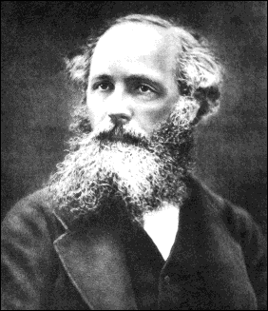

– GIGO –
Avoid false causality by correlating data!
Notes:
Darius
Beards
GIGO
Correlation is a MUST HAVE: fuzzy data is being measured and expensive business decisions are being made!
Looking just at message boards will kill you: highly skewed!

Slide 19
GIGO: Multiple views of data provides a deeper understanding and fewer analysis errors
Player and game actions
Minute 1
AI: open door
AI: cook food
Minute 2
Game: fire breaks out
AI
data
Screenshots
Screenshots
Time
Minute one
Minute two
Notes:
Larry: correlated data makes it more trustworthy and easier to understand / fix
Darius: data mine forums too (triangulate data from multiple views to validate), but note skew of forum data (love/hate publish more than others)
slightly non-orthogonal data? [Darius, what did you mean here?]

Slide 20


Business Intelligence has driven the success of many other industries for years!
Las Vegas Strip
Notes:
Larry:
What’s irritating is that Business intelligence drives many other industries (TV, casinos, cell phones,…) with great success.
They would kill for access to the breadth and depth of data we have on our customers, and how they interact with our products.
Harrah’s CIO: . [metrics] is one of the best investments that we have ever made as a corporation
And worse, we’ve already done the hard bit: most of our key data is already in a database!
<> Background only <>
Casino games: “This is one of the best investments that we have ever made as a corporation and will prove to forge key new business strategies and opportunities in the future.“ John Boushy (Harrah's CIO, 2000)

Slide 21
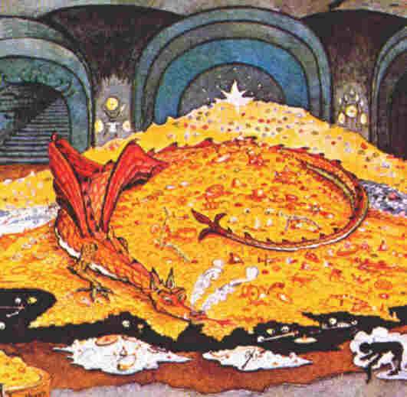
Data mining is pure gold!
Why aren’t we all doing it?
Notes:
Larry: Darius and I have been doing a lot of work with metrics over the past several years in online games. And even though developers love the metrics, once they’d seen them, the growth of metrics in the online space has been puzzlingly slow, and often done by passionate individuals, not by the project as a whole.
So I did a quick review of my projects over the past 20 years, some with metrics, some without, looking for differences in how we got to metrics. The first thing I noticed was that programs with strong metrics consistently outperformed programs with weak metrics, and the 2nd thing was that I didn’t use metrics on ALL my projects!
Now, I’m not a complete idiot, and even with having had multiple successes with them, even I didn’t use them all the time!
Once I finished cursing myself out on missing the correlation before and not insisting on metrics for all my projects, I realized there most be some subtle yet strong force that’s slowing down the spread of online game metrics.
Why is something so patently obviously useful, so underutilized?
It’s even more puzzling when you look at the nature of our industry. Online games are a long-term dollars in/dollars out service: measure & optimize to reduce costs and increase profit/user

Slide 22
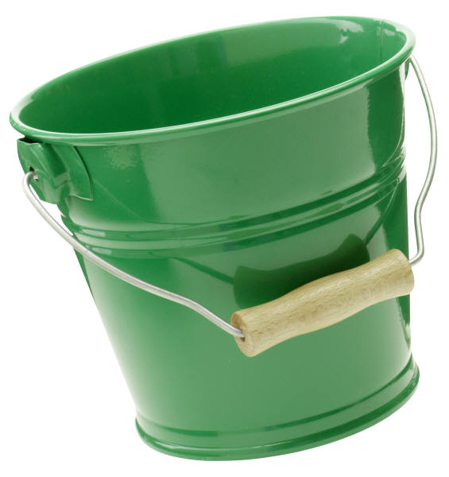
Issue: hard to get funding for non-feature code
Nobody wants to pay for it, because no one has traditionally paid for it! (‘pixels on screen’ syndrome needs culture shift)
☹
$$$$$$$$$$
$$
Features
QA
Metrics, CS, …
Notes:
Larry:
Quote from experienced MMO client engineer sums it up:
“Yep, this metric stuff is great, but why would I do it again? I have features on my to do list that I get measured by, not tools.”
So who pays the price is usually the poor person who builds a tool for their own needs, and it quickly falls apart when they move on to the next task.
Or you find the rare case like Darius who finds a way to kick-start a metrics system and grow it from a small sample into a valuable, team-wide tool.

Slide 23

Can’t get funding: roll your own metrics tool…
Diasporas trash tool growth
Rot sets in at record pace!
Notes:
Larry: we live in a highly migratory industry, carrying your tools around is rarely possible
Every old code base I’ve dug around in, I found several dusty skeletons of metrics ghosts left behind, and the only guy who knows how it works is off on the next project, starting all over, combating features for money again, and selling the use of metrics into the team, again
I’ve built over a dozen metrics systems, and I’ve only ever seen two survive my leaving (Tip: make it self-monitoring and part of day to day PROGRAMMER tasks, as they’ll fix it as soon as it breaks, if THEY need it!)

Slide 24
Automation overview
(tests and bots)
Dynamic asset updater
Asset manager ‘bot to touch all files and force refresh

Slide 25

Automated testing
(1)
Repeatable tests, using N
synchronized game clients
Test Game
Button
(2)
High-level, actionable
reports for many audiences
Programmer
Development Director
Executive
Notes:
Add: big green button, multi-clients
$$ sign, people’s time
DD hat, eng hat, exec hat
“tag line”

Slide 26
Other Automation Applications
QA & Production task accelerants
Speed bottlenecks, have CPU do long, boring tasks that slow down people
  Automated T&M combo can do a lot!
  Triage support from code & test & metrics
  Jumpstart for manual testers
  Level lighting validation, …
CPUs are cheaper, work longer, and make boring tasks easier
  Gives new validation steps that just aren’t possible via manual testing
    Repeatable scale testing @ engineer level
    Massive asset cost/benefit analysis
    Triage support for code and content defects: speed, speed, speed!

Slide 27
Automate non-game tasks too!
Example:
  Task assignment, report and track (close to standard work flow tools, except Prod and auto test support)
  We used simple state machine: 2 weeks work
  Faster test start/triage & answer aggregations
Integrate manual/auto test steps to catch best of both skill sets
  Semi-automated testing

Slide 28
Process Shifts: Automated Testing increases developer and team efficency
Stability
Keep Developers moving forward, not bailing water
Scale
Focus Developers on key, measurable roadblocks

Slide 29
Automated testing accelerates large-scale game development & helps predictability
Earlier
Ship Date
%
Complete
Oops
autoTest
Time
Initial
Launch
Date
TSO case study: developer efficiency
Strong test support
Weak test support

Slide 30
Stability Analysis:
What Brings Down The Team?
Test Case: Can an Avatar Sit in a Chair?
use_object ()
  Failures on the Critical Path block access to much of the game.
buy_object ()
enter_house ()
buy_house ()
create_avatar ()
login ()

Slide 31
Handout notes:
(repeatable tests & actionable results are multi-purpose tools)
Automation
  Speed and stability of QA, Production
  Fast, cheap find/fix/verify/deploy cycles in QA, Ops.
Caveats
  Process changes required: often harder than building the tech!
  Advanced automated testing is only do’able with hooks in code: how do you get Production buy-in?
Metrics: catch-22
  Easy sell, once you have useful charts
  Can’t get useful charts without resources
Automated tests and metrics provide a clear, measurable view of where the game really is, right now
Testing metrics often become a critical part of management's observation of production, like bug counts, because there is a hard, measurable line to support milestones and funding

Slide 32
Handout notes: automated testing is a strong tool for large-scale games!
Pushbutton, large-scale, repeatable tests
Benefit
  Accurate, repeatable measurable tests during development and operations
  Stable software, faster, measurable progress
  Base key decisions on fact, not opinion
Augment your team’s ability to do their jobs, find problems faster
  Measure / change / measure: repeat
Increased developer efficiency is key
  Get the game out the door faster, higher stability & less pain

Slide 33
Handout notes: more benefits of automated testing
Comfort and confidence level
  Managers/Producers can easily judge how development is progressing
    Just like bug count reports, test reports indicate overall quality of current state of the game
  Frequent, repeatable tests show progress & backsliding
  Investing developers in the test process helps prevent QA vs. Development shouting matches
  Smart developers like numbers and metrics just as much as producers do
Making your goals – you will ship cheaper, better, sooner
  Cheaper – even though initial costs may be higher, issues get exposed when it’s cheaper to fix them (and developer efficiency increases)
  Better – robust code
  Sooner – “it’s ok to ship now” is based on real data, not supposition

Slide 34
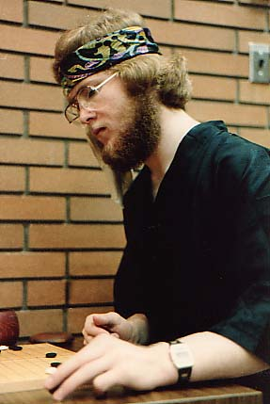

Larry Mellon: Consultant
(System Architecture, Writing, Automation, Metrics)
Research era
Alberta Research Council & Jade Simulations
  Distributed computing, 1982+
  Optimistic computing, 1000+ CPU virtual worlds
  Fault-tolerant cluster computing
Synthetic Theatre of War: virtual worlds for training
  DARPA: 50,000+ entities in real-time virtual worlds
  ADS, ASTT, HLA & RTI 2.0, interest management
Wife era
EA (Maxis): The Sims Online, The Sims 2.0
  Scalable simulation architecture
  Automated testing to accelerate production and QA
  Player, pipeline & performance metrics
Emergent Game Technologies (CTO)
  Architect for scalable, flexible MMO platform
Notes:
Larry: I started out in parallel processing about 20 years ago, and found that I just couldn’t solve some of the programming problems without first finding some way to measure and analyze the system as a whole.
When we spun off some of our most promising research into Jade Simulations, it got even worse, as our source code Frankenstein’ed on us as we grew.
We found that, just as in engineering we had needed metrics to solve the implementation problems, we found that we needed process metrics to solve our inefficiencies and unpredictability on delivery.
When I joined EA, I found that The Sims Online and The Sims 2.0 suffered from many of the same engineering problems, so we were able to import successfully some of the automated testing, software architecture and automated measurement/optimization ideas, but tailored for games.
Same again when I was running engineering teams or being a CTO: Good metrics, appropriate to the tasks for that hat, made work easier and faster. Conversely, poor metrics made the work go slower, more painful, and with more unpredictability
I now work for myself: consulting and training game teams on automated testing, virtual world architectures and metrics.

Slide 35
Brian DuBose
(QA manager, Bioware Austin)
Bioware MMO
Previously Tiberon
UO
Picture(s)
…
Notes:
Larry: I started out in parallel processing about 20 years ago, and found that I just couldn’t solve some of the programming problems without first finding some way to measure and analyze the system as a whole.
When we spun off some of our most promising research into Jade Simulations, it got even worse, as our source code Frankenstein’ed on us as we grew.
We found that, just as in engineering we had needed metrics to solve the implementation problems, we found that we needed process metrics to solve our inefficiencies and unpredictability on delivery.
When I joined EA, I found that The Sims Online and The Sims 2.0 suffered from many of the same engineering problems, so we were able to import successfully some of the automated testing, software architecture and automated measurement/optimization ideas, but tailored for games.
Same again when I was running engineering teams or being a CTO: Good metrics, appropriate to the tasks for that hat, made work easier and faster. Conversely, poor metrics made the work go slower, more painful, and with more unpredictability
I now work for myself: consulting and training game teams on automated testing, virtual world architectures and metrics.

Slide 36
Common Gotchas
Not designing for testability
  Retrofitting is expensive
Blowing the implementation
  Brittle code
  Addressing perceived needs, not real needs
Use automated testing incorrectly
  Testing the wrong thing @ the wrong time
  Not integrating with your processes
  Poor testing methodology
Notes:
Use bat / fat charts

Slide 37
Testing the wrong time at the wrong time
Applying detailed testing while the game design is still shifting and the code is still incomplete introduces noise and the need to keep re-writing tests
Build Acceptance Tests (BAT)
Stabilize the critical path for your team
Keep people working by keeping critical things from breaking
Final Acceptance Tests (FAT)
Detailed tests to measure progress against milestones
“Is the game done yet?” tests need to be phased in

Slide 38
Handout notes: BAT vs FAT
Feature drift == expensive test maintenance
Code is built incrementally: reporting failures nobody is prepared to deal with yet wastes everybody’s time
Automated testing is a new tool, new concept: focus on a few areas first, then measure, improve, iterate

Slide 39
More gotchas: poor testing methodology & tools
Case 1: recorders
  Load & regression were needed; not understanding maintenance cost
Case 2: completely invalid test procedures
  Distorted view of what really worked (GIGO)
Case 3: poor implementation planning
  Limited usage (nature of tests led to high test cost & programming skill required)
Case 4: not adapting development processes
Common theme: no senior engineering analysis committed to the testing problem

Slide 40
Handout notes: more gotchas
Automating too late, or too much detail too early
No ability to change the development process of the game
Not having ways to measure the effects compared to no automation
People and processes are funny things
  Sometimes the process is changed, and sometimes your testing goals have to shift
Games differ: a lot
  autoTest approaches will vary across games

Slide 41
Test coverage requirements drive automation choices:
Regression, load, build stability, acceptance, …
Upfront analysis
What are your risk areas & cost of tasks versus automation cost
  Example: Protect your critical path!
  Failures on the Critical Path slow development.
  Worse, unreliable failures do rude things to your underwear…

Slide 42
Metrics Rule!!
Actual data is more powerful than any number of guesses, and can be worth its weight in gold…
Notes:
Larry: Darius and I have been doing a lot of work with metrics over the past several years in online games. And even though developers love the metrics, once they’d seen them, the growth of metrics in the online space has been puzzlingly slow, and often done by passionate individuals, not by the project as a whole.
So I did a quick review of my projects over the past 20 years, some with metrics, some without, looking for differences in how we got to metrics. The first thing I noticed was that programs with strong metrics consistently outperformed programs with weak metrics, and the 2nd thing was that I didn’t use metrics on ALL my projects!
Now, I’m not a complete idiot, and even with having had multiple successes with them, even I didn’t use them all the time!
Once I finished cursing myself out on missing the correlation before and not insisting on metrics for all my projects, I realized there most be some subtle yet strong force that’s slowing down the spread of online game metrics.
Why is something so patently obviously useful, so underutilized?
It’s even more puzzling when you look at the nature of our industry. Online games are a long-term dollars in/dollars out service: measure & optimize to reduce costs and increase profit/user

Slide 43
Collecting ALL metrics is counter-productive
Masses of data clog analysis speed
Can’t see forest: too many trees in the way!
Useful metrics also vary by game type & whims of the metrics implementer ☺
Having a single metrics system is key
  Correlations between server performance and user behavior
  Lower maintenance cost
  Multiple users keep system running as staff and projects turn over (TSO: several ‘one offs’ rotted away)

Slide 44
The “3P's” model of game metrics
Player
Performance
Process
Notes:
Darius:
The high-level point is that considering the scale and complexity of online games, as service, metrics provide a massive advantage to all aspects of developing and running your service.
Player data: is about how the players interact with the game systems and also how they interact with each other. Users of this data: design team, marketing team, community management, customer support, EVERYONE!
Performance:
there’s a lot of things that have to happen just right for a MMO to work at all, let alone efficiently!
and you hit some of the harder computer science problems building these things:
Process: efficiency, stability and speed of the development and operational processes of an online game!
Overall, what is the turnaround time for fresh, stable content to customers?
All the way from raw code to live servers…

Slide 45
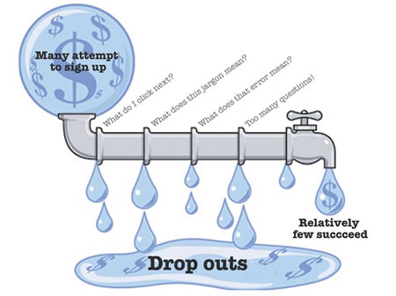
Player metrics:
Comparing groups of players is very valuable!
Notes:
Larry:
And out of all the people who sign up to try your game, wouldn’t you like to look at the difference between players who became a revenue source and players who didn’t?
First ½ hour makes or breaks you…

Slide 46
Process metrics
Find the leaks that are slowing you down or costing you money!
Another cultural problem
  Process = evil
  Tools != game feature
    Not ‘fun’ to build
    No ‘status’
  Thus, junior programmers inherit team critical (and NP-hard) problems…
Notes:
Larry
Process work, like metrics work, is not one of the sexier projects, like a game feature is. Culturally, this means process work falls down the programmer pecking order to the person least able to actually deal with a scalable, stable pipeline!

Slide 47
Fixing development leaks is like adding free staff!
Mythical man month…
Developer and team efficiency improvements
Notes:
Larry: game projects are notorious for inefficiencies in development. So measure them, and improve the bottleneck, if it is cost-effective!
[TSO build example: ‘probably’ not too often or severe, UNTIL YOU TALK TO THE TEAM, and find 80% lost work
[TSO with a stable build: DD quote (“sniff test [stability] saved us”
[TSO: “code change to play test”, this is a great measure to focus on.
Because the game is a tool used in building the game, a slow turnaround time on this slows your team’s efficiency if they can’t get the latest version of the game.
It also impacts your design team, who needs fresh and fast builds as the ideas and metrics flow in]
Project efficiency is really how I like to look at this. By making people’s jobs easier and faster to do, we make more money with less headaches.
You’ll be releasing new content for the multiyear lifetime of your MMO. Not investing in any efficient, stable, scalable pipeline is simply foolish.

Slide 48
Culture Shift option:
Treat metrics as a critical feature from day one!
Fund everything that helps both team and customers, not just game play!
$$$$$$$$$$
$$$$
$$!!!
Features
QA
Metrics
Notes:
Larry
Executive level start is no guarantee of success either: allocate funds to metrics as a mission-critical feature for the decade of software development and operations, and implement that system with measurable milestones and key systems coming online first (or somebody steals your programmers for a ‘more important’ game feature)
Jade/Cleary example: cash model is what execs understand. It wasn’t until I explained the loss of programmer efficiency in terms of dollars lost per month, could I get funding for a small tool ( back in the early days of c++ Front, we had scaled the initialization of static constructors to the point where a link took 30 minutes, for even the smallest compilation change, leaving 15 programmers sitting on their thumbs for literally hours each day)
Eventually, HE said “we can’t afford NOT to build this tool!” (make it his idea, and you’ve won ☺ )
[TSO example that failed: the metric system was not tracked at the same level of importance as game features, and it also fell down the programmer pecking order to the guys least capable of doing it, again, because metrics were not a cool in game feature!]

Slide 49

Metrics accelerate the triage process by providing a starting point that would take hours/days to find via log trolling
Notes:
Larry:
most of your time in a bug fix is just finding where to start in a massive, complex system!
Metrics are the best way to use the computer to do the grunt work of narrowing down the search area to something smaller (and usually something that just looks odd), and then call a human over to look at it
[TSO example: most of the bugs in The Sims Online were easily tracked back to five major game components, right at the C++ file level with an easy metric]

Slide 50

‘bots flag patterns of data that show common design errors
Notes:
Larry:
Higher-level views of data show you the pattern of things you must change (jade implementation example)
Customer: “my simulation only runs 400 times faster than when I use one CPU, but I’m using 1000+ CPUs”
“here’s a few Tbytes of data that might tell you why: please fix by Friday, as I’m briefing Congress on why we needed a 1000+ supercomputer instead of the 400 CPU version”
So I built a ‘bot to find the usual blocking patterns, popped up a chart, and he fixed the problem himself! Days of analysis were replaced by “look at this chart”

Slide 51
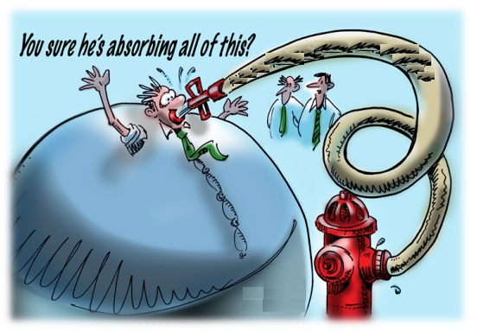
Scaling the metrics system as data scales
Automated aggregation avoids drowning in masses of data
Fast response is key to adoption
Notes:
Larry:
Response times (when slow) impact adoption of metrics, so check it constantly
Add hardware
Remove crufty old data, cache key views, …
Give them filters, and turn on/off specific metrics
Make it easy for them to add their own metrics
ALWAYS put metrics on your metrics system: observe your users and gain tips (Jade MoM gave me quick fix option for failed TSO fancy metrics system)

Slide 52
Iterative improvement via metrics + automated testing: Lower dev & ops costs
Profit…
New
Content
~ $10
per
customer
Regression
Customer
Support
Operations

Slide 53
Iterative improvement: Lower dev & ops costs
Profit…
Lower New Content Cost
~ $10
per
customer
Regression
Customer
Support
Operations

Slide 54
Iterative improvement: Lower dev & ops costs
Profit…
Lower New Content Cost
~ $10
per
customer
Lower Testing Cost
Customer
Support
Operations

Slide 55
Iterative improvement: Lower dev & ops costs
Profit…
Lower New Content Cost
~ $10
per
customer
Lower Testing Cost
Happy Customers Don’t Call
Operations

Slide 56
Iterative improvement: Lower recurring costs
What tuning factors are useful to you?
Profit…
Lower New Content Cost
~ $10
per
customer
Lower Testing Cost
Happy Customers Don’t Call
Operations
Lower bandwidth & CPU

Slide 57
Guiding MMO growth & modifying user behavior
The ‘Big Three’ Business Metrics
  Cost of customer acquisition
    Player analysis -> design improvement and marketing
  Cost of customer retention
    Stable servers, fast content refresh via autoTest&Measure
    Tailor new content via analyzing player behavior
  Cost of customer service
    Lower recurring costs via automation & metrics
    Stable servers & metrics reduce CS calls
    Metrics reduce CS call duration
Metrics of income per user & per user type allows
    More income per users & groups
    Identify & address expensive customers…

Slide 58
Hard MMO task: fast cycle time
Why do we want rapid iteration?
  Metrics + automation lets you
    fish for fun
    Fish for defects, esp. non-det bugs
  Triage / fix defects while Live

Slide 59


Iteration is how you find fun!
(innovative fun and polish set you apart in the market)
(iterative innovation lowers MMO risk & grows customer base)
Alpha
Live
Fast
polish
Explore designs
Iteration
Rate
Slow
finish
Stick to one plan
Time

Slide 60

Stability & metrics allow earlier test/feedback
Project Start
Launch
Notes:
Darius: we learned a lot about applying metrics feedback in a rapid iteration cycle.
From Nik:
Players will lie when asked in forums or focus surveys, but their behavior can't lie.
Through good data reporting tools, we can ask questions about their actual behavior, and use those to modify the design and balance of the game.
On Lord of the Rings, the changes made following each beta stage improved the player experience, as measured by both surveys and preorder numbers.
The designers had something Nik calls their secret weapon: Data. Real data, that allowed them to ask the right questions, and get answers borne out by behavior, not opinion.
Fast (2 week) iteration on ALL parts of the user experience, not just game play: CS, QA, Ops, … AND what metrics we needed to add to the next iteration
Larry: note also efficiency of starting earlier!
The earlier you start this cycle, the better off you are in not just game play, but also avoid wasting time/$$ on dead-end paths:
more time for polish, or
More time & lower risk to create a new TYPE of game, breakouts like The Sims or Quake
AND changes to a big game at the end cycle are HARD AND SLOW

Slide 61
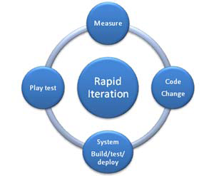
Rapid iteration & rapid response
The faster and more reliable your MMO can pass through a Full Rapid Iteration Cycle, the more chances you will have of finding the elusive fun factor that will set you apart in the market place. Rapid iteration also helps live operations find and fix critical failure points.

Slide 62
Handout notes:
Process changes are required to make these useful
How do you get buy-in from production?
  Automation and metrics provide a clear, measurable view of where the game really is, quite now.
  Do something that demonstrably helps them in both QA-interactions and their other day to day tasks
Metrics often become a critical part of management's observation of production
  There is a hard, measurable line that provides a different view of the game than the traditional bug count and "playability feel" of the game
  Executives can view the system from multiple angles and make critical funding and milestone decisions. [TSO and EGT examples: I needed same & diff metrics, and was blind without them]
Useful engineering tool
  Stability on Mainline, easier bug reproduction, multi player support
Stable development platform (the game is a tool used in building the game)
Lower ‘go back’ costs
  GO BACK COSTS ARE FINALLY MEASURABLE!!!

Slide 63
Handout notes:
The Law of Large Numbers
A small cost multiplied by a large number becomes a large cost
  Overhead per task, global state, resource footprint
  …
A small risk of failure repeated a large number of times becomes a large risk of failure
  Bleed through errors on change
  Race conditions
  Build failures
  Resource caps
  Worst-case behavior
  …

Slide 64
Handout notes: picking automation areas (covered where?)
Goal: automation of test & measure & time-intensive QA/Prod tasks
  Rapid iteration in Production and Live
  Low cost, high accuracy test coverage across builds & scales & SOAK times & synchronized multi-player
  Less QA & engineering time fixing something that used to work (build regression): this needs to grow/change with design & schedule (lessons learned: don’t automate too much, too quickly) [grab BAT / FAT slide)
  Tools rock cost-wise in long-term service biz that needs happy customers and working code and fast new content
  Examples: Prod and QA
Caveat: many auto test tools only address a small slice of the MMO testing problem…
  Unit tests help programmers, but not content, scale, integration or progress
  DEFINE YOUR TESTING SPACE BEFORE PICKING AN APPROACH!!

Slide 65
Automated testing components
Any Game
Startup
&
Control
Repeatable, Sync’ed
Test I/O
Collection
&
Analysis
Test Manager
Test Selection/Setup
Control N Clients
RT probes
Scriptable Test Client(s)
Emulated User Play Session(s)
Multi-client synchronization
Report Manager
Raw Data Collection
Aggregation / Summarization
Alarm Triggers
Notes:
System has three components
Initialization & control
Generation of repeatable, synchronized input
Analysis of results
LOE varies
SSP: shell script driver, .txt file, diff()
MMP: major sub-systems
[then in “driving factors” we talk about TSO scale & complexity of input (sync, …)

Slide 66
Input system: options
scripted
algorithmic
recorders
Game code
Multiple test applications are required, but each input type differs in value per application. Scripting gives the best coverage.
Notes:
Visual
Test names & Test types
Cost & summary tag line
And, the str/weakness per??

Slide 67
Input (Scripted Test Clients)
Pseudo-code script of users play the game, and what the game should do in response
createAvatar [sam]
enterLevel 99
buyObject knife
attack [opponent]
Command steps
…
Validation steps
checkAvatar [sam exists]
checkLevel 99 [loaded]
checkInventory [knife]
checkDamage [opponent]
…
Notes:
Visual
Player actions & validation actions, on either side of a scripted session
& benefits msgs

Slide 68
Scripted Players: Implementation
Test Client (Null View) Game Client
Or, load both
Script Engine
Game GUI
State
State
Commands
Presentation Layer
Game Logic
Notes:
Three big wins here:
“we test with the same client logic we ship with”
“we get most of the test client for free”
“the test rig is always up to date”
Use live game code for the Test Client
Add a Presentation Layer to separate the Client View from the Client Logic to create a NullView Client
Attach a scripting system to the Presentation Layer
The game cannot distinguish who generates an event: a player, or a script

Slide 69
Handout notes:
Scriptable for many applications: engineering, QA and management
Unit testing: 1 feature = 1 script
Recorders: ONLY useful for one bug, on one CPU, on one build
Load testing: Representative play session, times 1,000s
  Make sure your servers work, before the players do
Integration: test code changes for catastrophic failures
Build stability: quickly find problems and verify the fix
Content testing: exhaustive analysis of game play to help tuning and ensure all assets are correctly hooked up and explore edge cases
Multi-player testing: engineers and QA can test multi-player game code without requiring multiple manual testers
Performance & compatibility testing: repeatable tests across a broad range of hardware gives you a precise view of where you really are
Project completeness: how many features pass their core functionality tests; what are our current FPS, network lag and bandwidth numbers, …

Slide 70

Handout notes
Automated testing: strengths
Repeat massive numbers of simple, easily measurable tasks
Mine the results
Do all the above, in parallel, for rapid iteration
  “The difference between us and a computer is that the computer is blindingly stupid, but it is capable of being stupid many, many millions of times a second.”
  Douglas Adams (1997 SCO Forum)

Slide 71
Handout notes: design factors
Test overlap & code coverage
Cost of running the test (graphics high, logic/content low) vs frequency of test need
Cost of building the test vs manual cost (over time)
Maintenance cost of the test suites, the test system, & churn rate of the game code

Slide 72
Handout notes:
Automation focus areas (Larry’s “top 5”)
Performance
→
Scale is hard to get right
Critical path stability
→
Keep team going forward
Non-determinism
→
Gets in the way of everything
Content regression
→
Massive, recurring $$
Compatibility & install
→
Improves life for you & user

Slide 73
Handout notes:
Content testing (more examples)
Light mapping, shadow detection
Asset correctness / sameness
Compatibility testing
Armor / damage
Class balances
Validating against old userData
… (unique to each game)

Slide 74
Load testing catches non-scalable designs
Local data
Local data
Local data
Global data
Global data
(SP) all data is always available & up to date
(MP) shared data must be
packaged, transmitted, unpackaged,
and constantly refreshed
Scalability is hard: shared data grows with #players, AI, objects, terrain, …, & more bugs!

Slide 75
Load testing: find poor resource utilization
22,000,000 DS Queries! 7,000 next highest

Slide 76
Handout notes: why you need load testing
Case 1, initial design: Transmit entire lotList to all connected clients, every 30 seconds
Initial fielding: no problem
  Development testing: < 1,000 Lots, < 10 clients
Complete disaster as clients & DB scaled
  Shipping requirements: 100,000 Lots, 4,000 clients
DO THE MATH BEFORE CODING
  LotElementSize * LotListSize * NumClients
  20 Bytes * 100,000 * 4,000
  8,000,000,000 Bytes, TWICE per minute!!

Slide 77
Handout notes: some examples of things caught with load testing
Non-scalable algorithms
Server-side dirty buffers
Race conditions
Data bloat & clogged pipes
Poor end-user performance @ scale
… you never really know what, but something will always go “spang!” @ scale…

Slide 78
Stability & non-determinism (monkey tests)
Continual Repetition of Critical Path Unit Tests
Code Repository
Compilers
Reference Servers

Slide 79
Handout notes:
AutoTest addresses non-determinism
Detection & reproduction of race condition defects
  Even low probability errors are exposed with sufficient testing (random, structured, load, aging)
Measurability of race condition defects
  Occurs x% of the time, over 400x test runs
  Prod: ‘fix it’ template
  QA: validate

Slide 80

Monkey test: enterLot ()
Notes:
This slide shows the results of running isolated tests against game features to track down failure rate of QA test suites.
The following slide gives the high-level view of results.

Slide 81
Monkey test: 3 * enterLot ()
Notes:
This slide shows the results of running isolated tests against game features to track down failure rate of QA test suites.
The following slide gives the high-level view of results.

Slide 82
Four different behaviors in thirty runs!

Slide 83
Build stability & full testing: comb filtering
Smoke Test, Server Sniff
- Is the game playable?
- Are the servers stable
under a light load?
- Do all key features work?
Sniff Test, Monkey Tests
- Fast to run
- Catch major errors
- Keeps coders working
Full Feature Regression, Full Load Test
- Do all test suites pass?
- Are the servers stable
under peak load conditions?
$
$$
$$$
Full system build
Promotable to
full testing
New code
Promotable
Cheap tests to catch gross errors early in the pipeline
More expensive tests only run on known functional builds

Slide 84
Handout notes:
Automated data mining / triage
Test results: Patterns of failures
  Bug rate to source file comparison
  Easy historical mining & results comparison
Triage: debugging aids that extract RT data from the game
  Timeout & crash handlers
  errorManagers
  Log parsers
  Scriptable verification conditions

Slide 85
Handout notes:
Automated test & measure tools help meet MMO requirements better/faster/cheaper
scalability is one of the key risk points for an MMO, and is really, really hard to test and measure without automation. (client count, data volume, query sets, code size/complexity, …)
Find the risk points in your own project, decide how important each one is and how much it would take to do with automation or manual.
You'll find some things are worth automating, and you'll find others that produce a tremendous reduction in time and thus allows greater test coverage and/or faster turnaround for the cost of automating that task.
  Eg: 8 testers in cube OR a script-driven test of 7 nullView and I fullView clients
  Eg: 500 people all hit “login” or “save” at same time!
  EG: Non-deterministic defects need new type of bug-reporting (TSO , Jade eg)
    How do you track & verify non-det bugs w/30% failure rate? (server engineer on TSO story: ran once!)
Nail down & automate your critical path, preferably with bypass switches for shard_selector/login: keep team working!

Slide 86
Handout notes: sources of data
Game player database, runtime probes in the servers, queries from the bug database, etc. note also multisource data: a very useful metrics is the number of bugs per module in your code base.
Tracked over time, you can save costs by reducing the "go back costs" per module. Go back costs are very hard to discover manually and thus continually leak money.
This also provides a more accurate view of the real cost of a feature!
Time to first check in is the only metric most teams pay attention to when rewarding people (probably because it is the only easily observable metric). This reinforces bad behavior and hides the true cost over time of that feature.

Slide 87
Handout notes: automation can speed the critical aggregation and interpretation phases of metrics.
It can also speed the testing cycle with simulated clients, data collection, multiplayer synchronization, load testing, feature testing, or...
key take away this section: automation can accelerate many tasks, not just testing. Examine your pipeline for continual failure locations or time critical bottlenecks, such as broken build frequency, or total time to pass/fail a particular build.
Developer efficiency is a key metric to capture, which can often be increased with automation. Use examples to drive the point home from multiple success stories. (TSO, Jade (pipeline&perf&tool budget))
  Pain existed, but fix not funded until quantified (we need features, not tools mentality can be shifted with simple spreadsheet!)

Slide 88
Handout notes:
Deciding what to test in a world of complexity and what is affordable to test?
QA cost is higher on some tasks than others. Look at eight man and hundred men test teams! Using automation makes more test possible to run for monetary reasons, and it makes more test possible to run by lowering the number of hands on keyboards required to run a test and replicate results.
Larry's new law "the more complex the system under development, the more you need a fast and accurate view of the system’s performance and functionality, resulting in faster team iterations, bug finding and game polish.

Slide 89
Process: sample metrics
Goback costs (TSO eg)
Task or test time vs value (now and over time)
Build failure rate & download time & load time
Peter charts

Slide 90
Scale: “every” &“all” design assumptions can be deadly…
(but metrics & testing catch failures)
22,000,000 DS Queries! 7,000 next highest

Slide 91
Handout notes:
“every” &“all” are dangerous!
(Use case: TSO’s Data Service)
Initial design: Transmit entire ReservedLotList to all connected clients, every 30 seconds
Initial fielding: no problem
  Development testing: < 1,000 Lots, < 10 clients
Complete disaster as clients & DB scaled
  Shipping requirements: 100,000 Lots, 4,000 clients
DO THE MATH BEFORE CODING
  Bandwidth & message processing
    LotElementSize * LotListSize * NumClients
    20 Bytes * 100,000 * 4,000
    8,000,000,000 Bytes, TWICE per minute!!
  And other resources too: DB queries

Slide 92
Handout notes:
The mythical man-month
(re-visited @ scale)
Hypothesis: increasing team efficiency is (at least) equivalent to adding new team members
Sample:100 person team, losing an average of 30% per day on
  Fixing broken bits that used to work
  Waiting for game / test to load
  Broken builds
Test case: 10% gain in team efficiency
  Creates a “new” resource: Fredrick B.
  Fred never takes vacation time or sick leave
  Fred knows all aspects of all code
  Fred makes everybody’s lives easier & more pleasant

Slide 93
Handout notes:
The mythical man-month
(re-visited @ scale)
Without Fred (40 hour work week)
  100 * 40 * .7 == 2,800
  100 * 40 * .8 == 3,200 [Iteration optimizations]
  Extra staff hours added: 400 (10 new Freds!)

Slide 94

Unstable builds are expensive & slow down your entire team!
Development
Bug introduced
Checkin
Repeated cost of detection & validation
Firefighting, not going forward
Build
Impact on others
Smoke
Feedback takes
hours (or days)
Regression
Play test
Notes:
too far down the development pipe to quickly react to error / change “Anything not in constant use by all developers will soon break”
Redo visual

Slide 95
Build & test: comb filtering for iteration speed
Smoke Test, Server Sniff
- Is the game playable?
- Are the servers stable
under a light load?
- Do all key features work?
Sniff Test, Monkey Tests
- Fast to run
- Catch major errors
- Keeps coders working
Full Feature Regression, Full Load Test
- Do all test suites pass?
- Are the servers stable
under peak load conditions?
$
$$
$$$
Full system build
Promotable to
full testing
New code
Playable
Cheap tests to catch gross errors early in the pipeline
More expensive tests only run on known functional builds

Slide 96
Scale may be our own Dinosaur Killer
(evolve or die…)
Oblivion: 2006
PS3 & Xbox 360 are hard enough: what about PS4?

Slide 97
Handout notes
Moore’s Law: pain now & more on the way
Current pain points
  PS3 (~Teraflop, via eight cores!), Xbox 360
  Multi-core PC & servers
Shift in chip designs
  Old: clock speed & cache at all costs
  New: threads at all costs
On the (short-term) horizon
  General-Purpose GPUs
    Nvidia GeForce 8800: 128 cores == concurrency pain
  Quad-core desktop processors & 8 to 32 core servers
  Sun’s Niagara: eight cores @ 4 parallel threads each
    32 concurrently running threads
    One thread == one process, or one process == 32 threads
    16-core Rock processor up next

Slide 98
Handout notes
Moore’s Law: long-term horizon?
Teraflop on a chip! (80 cores)
  Demo: motion capture, using only digital video
  “In the future, [Rattner said], it will be possible to blend synthesized and real-time video”
New memory models: TSV interconnect
  Stacks memory on top of a massively multi-core processor: direct memory connection to processor cores
  Transfer rates between the processor and memory of up to a terabyte per second
  TSV: Through Silicon Via
Next up: 1000+ cores per chip!

Slide 99
Handout notes: how do metrics help MMO requirements?
measuring the players provides insight into game design, community and marketing
Measuring the pipeline shows you frequent failure places and bottlenecks at scale
measuring the performance of both client and server allows you to improve the player experience, and save money by having people focused on the actual key tasks and not on a series of guesses
automatically collecting/aggregating/publishing masses of raw data into meaningful charts (if a metric exists in the forest, and nobody heard it, did it really exist?)
Measuring things that are too slow for a person to measure and aggregate
Analyzing your code for the total cost aggregate of development and repeated defects, helping guide re-factoring
Speeds full iteration rate

Slide 100
The “3P's”: of game metrics
Player
Performance
Process

Slide 101
Metrics-Driven Development: each group needs different metrics
Production
Metrics
Designers
Operations
Time on task
Fun zone
Dead zone
…
Engineers

Slide 102
Metrics-Driven Development
Metrics
CPU load per event
Lag time under load
…
Engineers

Slide 103
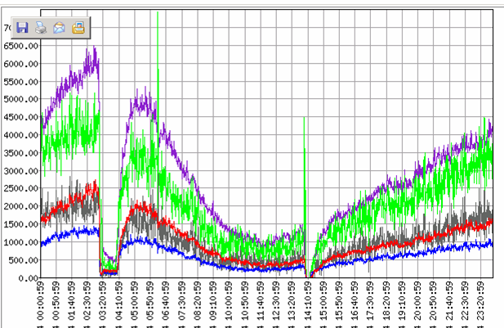
Engineering Metrics:
Aggregated Instrumentation Flags Trouble Spots
Server Crash

Slide 104
Metrics-Driven Development
Metrics
Operations
Number of each type of packet, over time
Client failure rate
Number of players per CPU
…

Slide 105
Metrics-Driven Development
Production
Percent of world terrain completed each month
Number of animations per month
Number of automated tests that pass each month
Broken build time wastage
Number of supportable clients each month
…
MUCH more valuable if you share these metrics team-wide!
Unified view of game
People respond to what they are measured by
Metrics

Slide 106
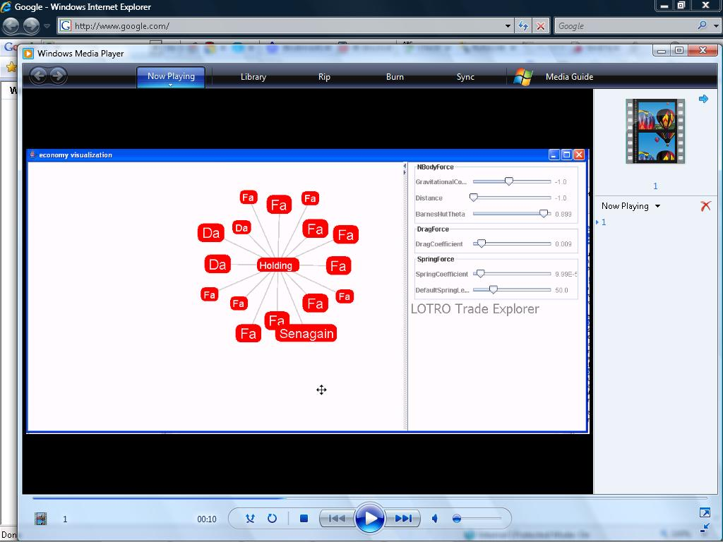
Tuning imbalances or exploits can throw your entire economy out of kilter, but remember to triangulate!
Metrics find hackers!

Slide 107
Unstable builds are expensive & slow down your entire team!
Development
Bug introduced
Checkin
Repeated cost of detection & validation
Firefighting, not going forward
Build
Impact on others
Smoke
Feedback takes
hours (or days)
Regression
Play test
Notes:
too far down the development pipe to quickly react to error / change “Anything not in constant use by all developers will soon break”
Redo visual

Slide 108
Prevent critical path code breaks that take down your team
Candidate code
Development
Sniff Test
Safe code
Pass / fail, diagnostics
Checkin
Notes:
too far down the development pipe to quickly react to error / change “Anything not in constant use by all developers will soon break”
Redo visual

Slide 109
Metrics change how you work!
Measure
Change
Measure
OR
Guess
Change
Guess

Slide 110
Favorite process metrics
Engineer efficiency: Compile / load / link times
System: Non-deterministic defects
‘Go back’ cost: bug frequency per source code file
Team iteration rate: Build times & failure rate

Slide 111
END: metrics
Need 2 eg of all three P’s!

Slide 112
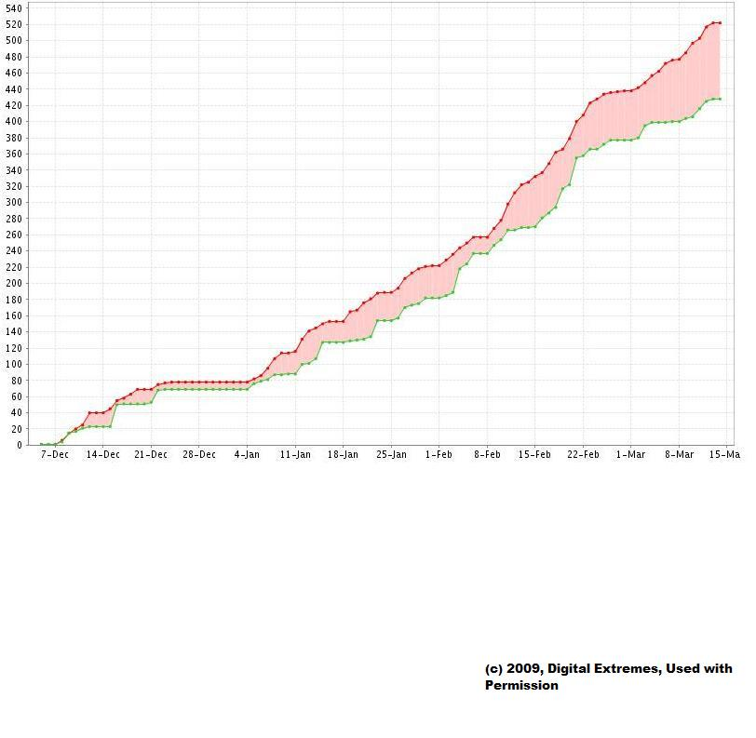
Process & performance metrics

Slide 113
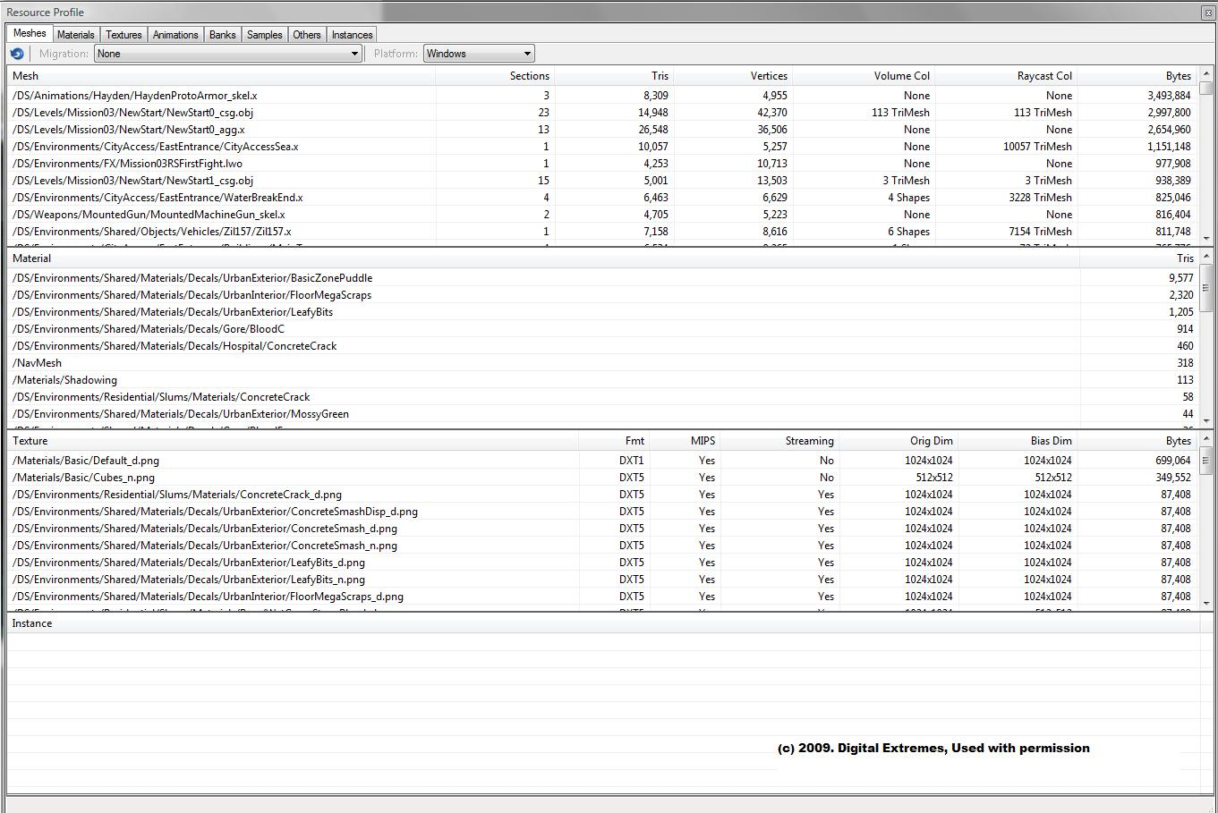
Process & perf metrics

Slide 114
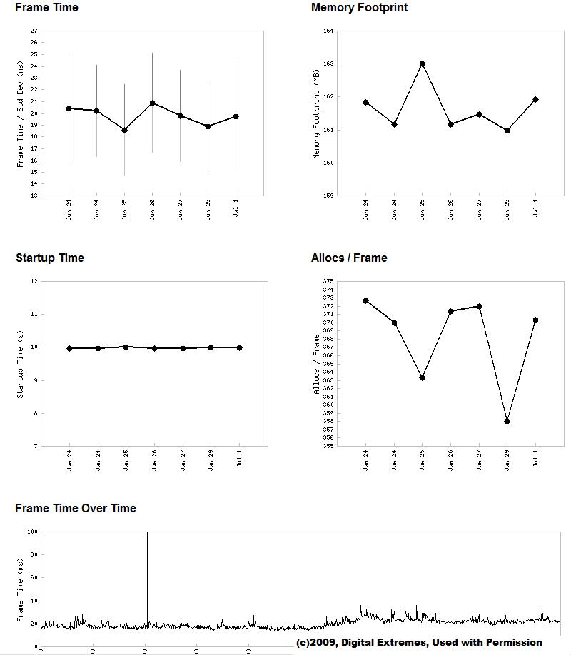
Process & perf metrics

Slide 115
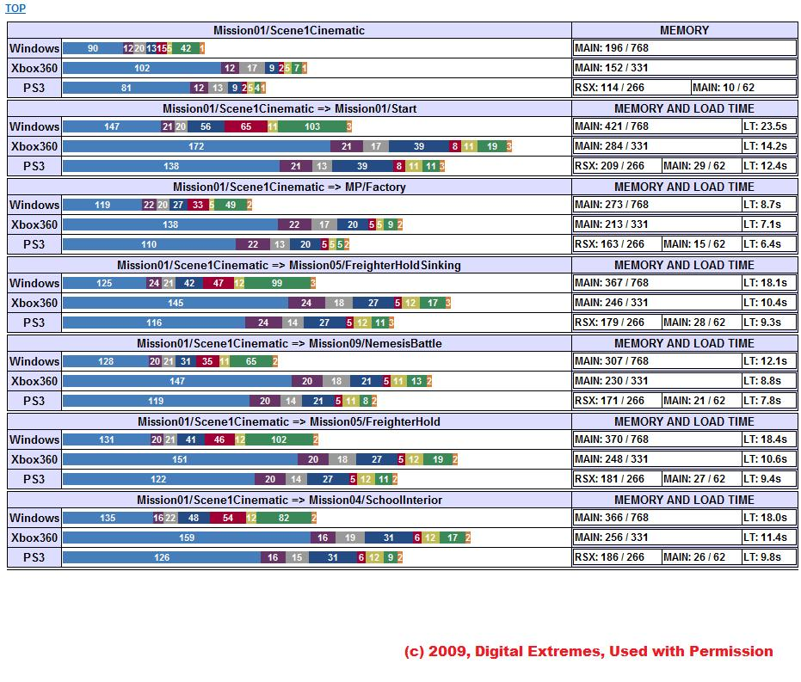
Process & perf metrics

Slide 116
How to succeed
Plan for testing early
  Non-trivial system needs senior engineering support
  Architectural requirement for automated testing brings costs wayyyy down!
Fast, cheap test coverage is a major change in production, be willing to adapt your processes and/or your tests
  Make sure the entire team is on board
  Deeper integration leads gives greater value
Kearneyism: “make it easier to use than not to use”

Slide 117
Yikes, that all sounds very expensive!
Yes, but remember, the alternative costs are higher and do not always work
Costs of QA for a 6 player game:
    Testers
    Consoles, TVs and disks & network
    Non-determinism
MMO regression costs: yikes²
    10s to 100s of testers
    10 year code life cycle
    Constant release iterations

Slide 118
Takeaways
(Test & Measure Tools are a vital part of $in - $out = $profit)
Automated tests provide
  Faster triage
  Increased developer & team efficiency
Metrics replace guesswork with facts
  Focus resources against real, not perceived, needs
  Feeding back player behavior into game design is pure gold…
‘User story’ nature of tests provides common measuring stick to everybody
Metrics motivate people & unifies view of progress and game

Slide 119

The migration online is a Darwinian moment for our industry
  Boxed goods culture must shift to online service
    Player Retention is key, not just features & cool graphics
    Rapid iteration gives fun & new content, but MMO complexity requires automation and a seamless team, not Prod vs QA
Notes:
Larry
So, you go home, and ask your boss for some money to spend on something generic called “metrics”
Typical response: my game costs are already skyrocketing, why do I need to spend money on yet another thing I never needed when I was in the trenches building games (says the dinosaur looking up at the streaking asteroid)
Like chip industry a few years back: scale & complexity had grown to where you switched to auto test or you were no longer in the chip biz

Slide 120
Question:
How would you rather live your life?
Measure
Change
Measure
OR
Guess
Change
Hope
Slides are online (next week) at http://www.MaggotRanch.com/biblio.html
Contact: larry_@_MaggotRanch.com

